Slide 1
SOCIAL MEDIA ANALYTICS FOR BUSINESS

Slide 2
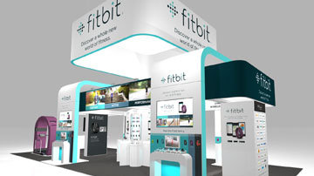

ABSTRACT
A development direction of the organization that sets its goal, task, and strategic objectives can be formulated in the first phase.
The next move is to consider the company its staff, its values, and its community in general.
Fitbit also provides a higher-cost premium level servicewith customized fitness instruction.
Organizing incidents in a sequence helps it to forecast the next several events.
The timetable frequently allows one to recognize the organization's ongoing issues.
Notes:
A development direction of the organization that sets its goal, task, and strategic objectives can be formulated in the first phase. These will normally be created using the history of the brand. The experience of a company is useful in a case study as it allows explaining the complexity of the options for the case study. The next move is to consider the company its staff, its values, and its community in general. This can be achieved by the past of the brand (de Zambotti, Goldstone, Claudatos, Colrain, and Baker, 2018). It may also be achieved with anecdotal cases of managers or workers, who are normally described in an HBR case study, to provide a true impression of the circumstance to the reader. Finally, a schedule must be developed for the problems and activities. Organizing incidents in a sequence helps it to forecast the next several events. It also encourages us to create solutions for the case study. The timetable frequently allows one to recognize the organization's ongoing issues.

Slide 3
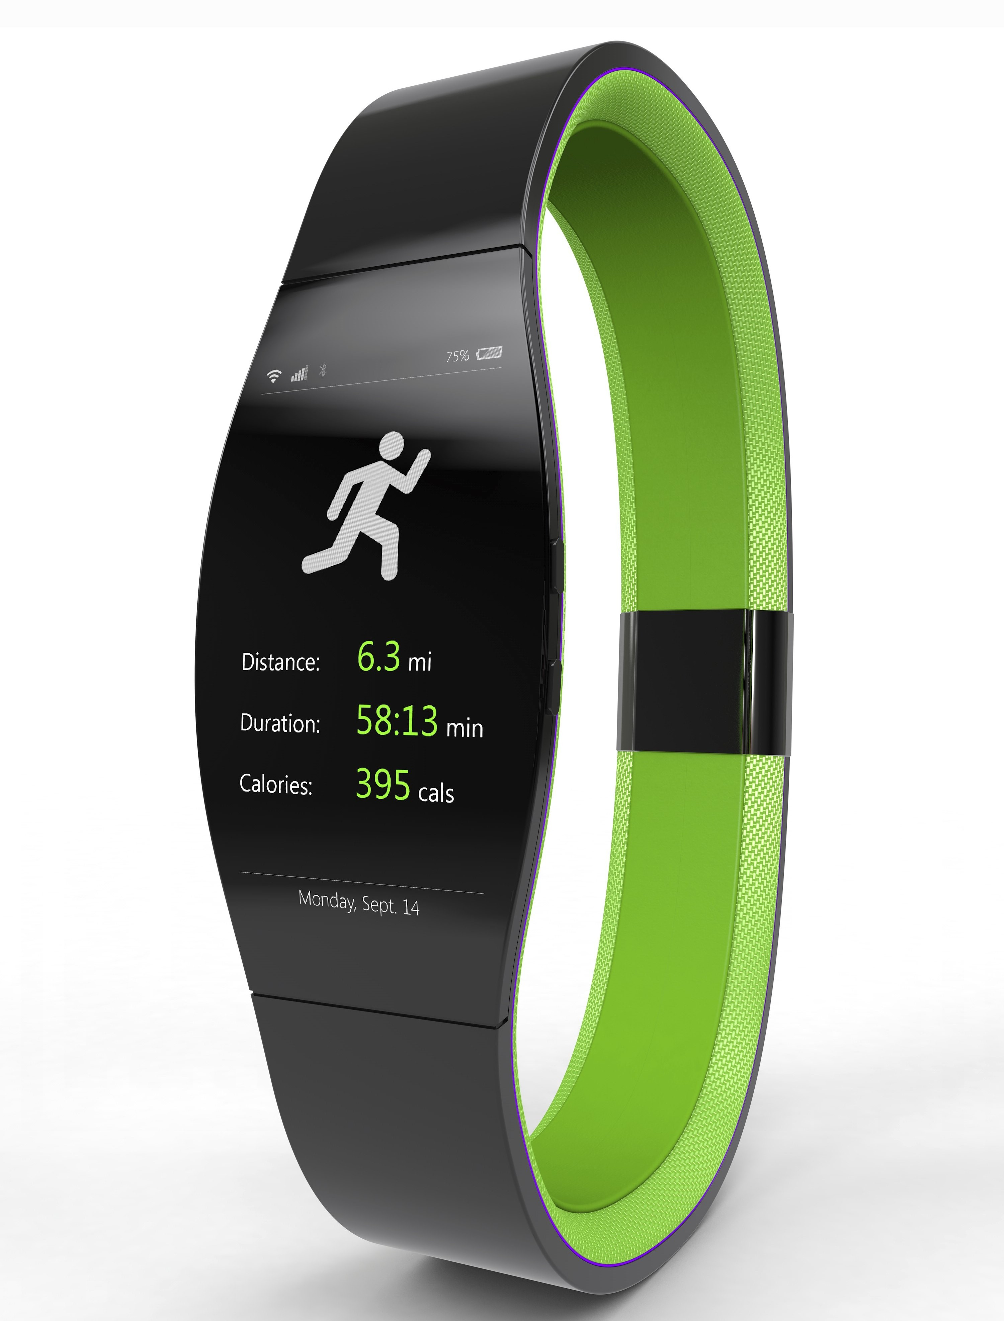
MOTIVATION FOR THE PROJECT
The case study does not conclude by simply advising on the topics involved. It analysis the scrapped data on Fitbit sense from twitter.
Understanding the market condition and customers review plays a vital role in driving decisions.
Fitbit reduced the total US market share by 25 percent but retained a significant market share in the span of the market.
The company followed the differentiate- and lowercase or fecality approach that has recently taken root in the marketplace
Notes:
The case study does not conclude by simply advising on the topics involved. One may also explain the implementation of these guidelines. This is shown by a correct structure for execution. As per the viewpoint of Benedetto, Caldato, Bazzan, Greenwood, Pensabene, and Actis (2018), a comprehensive application structure allows differentiating between a normal and an over-average case study response. It also defines the modifications and assumptions that have to be made. More than one solution to the case study is necessary. This alternative would be introduced where a shift of conditions was not or could not be found in the initially suggested remedy. The alternative approach for Fitbit is described as the initial plan with a corporate plan, a corporate level strategy, and others. The case study should not just provide advice on the problems involved. One could also explain how these guidelines will be applied. This is shown by a correct structure for execution (Haghayegh, Khoshnevis Smolensky, Diller, and Castriotta, 2019). A comprehensive structure for implementation helps differentiate between an average and an over-average case study response. It also sets out the modifications and assumptions that need to be included in the method. For example, the launch of Fitbit in the US in 2006 serves as a shining example of this concept. From the beginning, the corporation has benefited greatly from customers' adaptability and concurrence.

Slide 4
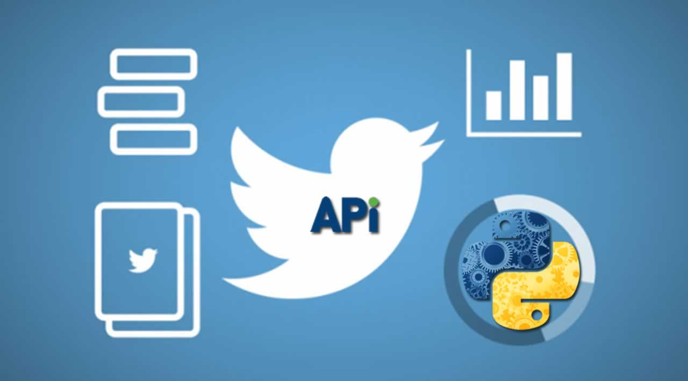
DESIGN AND DISCUSSION
To make business analytics for Fitbit sense, a huge amount of data is required. In order to do the data construction and cleansing some external support is utilized a stated below:
NLTK:
Is a NLP package provided by Python 3. This gives the capabilities to identify the root of words i.e., finding words having similar origin (Bird, et al., 2019).
IBM tone Analyser:
This is a service provided by IBM under the umbrella of IBM cloud services. This comes with unique capabilities to assess the sentiment in a phrase or text (IBM, 2015).
Notes:
To make business analytics for Fitbit sense, a huge amount of data is required to do that. This research is intended to do business analytics that requires data from diverse sources by overriding data generated using Twitter. To conduct this research, Twitter API is being used for this research. An API is referred to as application software that is capable of analyzing data found from various social media sources i.e. Twitter, Facebook, or Instagram. Not only these social networking sites are used to conduct this analysis, but also various live websites are being used to generate data from different users. For a better understanding of the APIs, it is working as a trader between the users. API’s consists of various kinds of coding, which is then accumulated to get the desired analysis outcome. As an example, when we order something from a website, we did not get that product directly from the warehouse. We have to be dependent on the delivery boy to get our product from the warehouse. Here that delivery boy is occupied as a trader or an API.
Data harvesting from Twitter
REST system or we can say Representational State System is the ultimate procedure by which is need to toil the API swiftly. This RSET system is responsible for reading & writing the datasets provided by the user. Twitter API is constructed using 4 partitions such as Tweets segment, user, entities & location unit. HTTP servers are needed to run these APIs swiftly. Data need to be extracted using different procedures from Twitter.
Beneath the home section, there is accessibility by which one can get the reviews of last month. In that section, the user can get all the data related to the activities such as the number of visitors increased or decreased, how many tweets have been posted in the last month, total numbers of posts that have been posted including all of the hashtags. Additionally, one can also check either the number of followers has been increased or not. (Vyshnavi, Venkata Raju, Vamsi Krishna and Bhavya Shree, 2017)

Slide 5
RESULT & VISUALIZATION

Slide 6
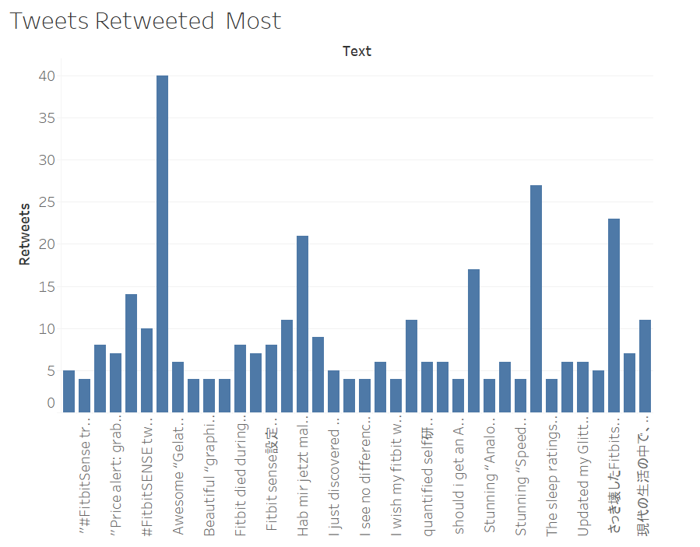
Retweet Analysis
It shows the retweet counts of tweets about Fitbit Sense in a span of 3 months. The tweets which have more than 3 retweets are only considered for visualization. We can see that some tweets are retweeted over 15 times. This amount of retweets demands attention.

Slide 7
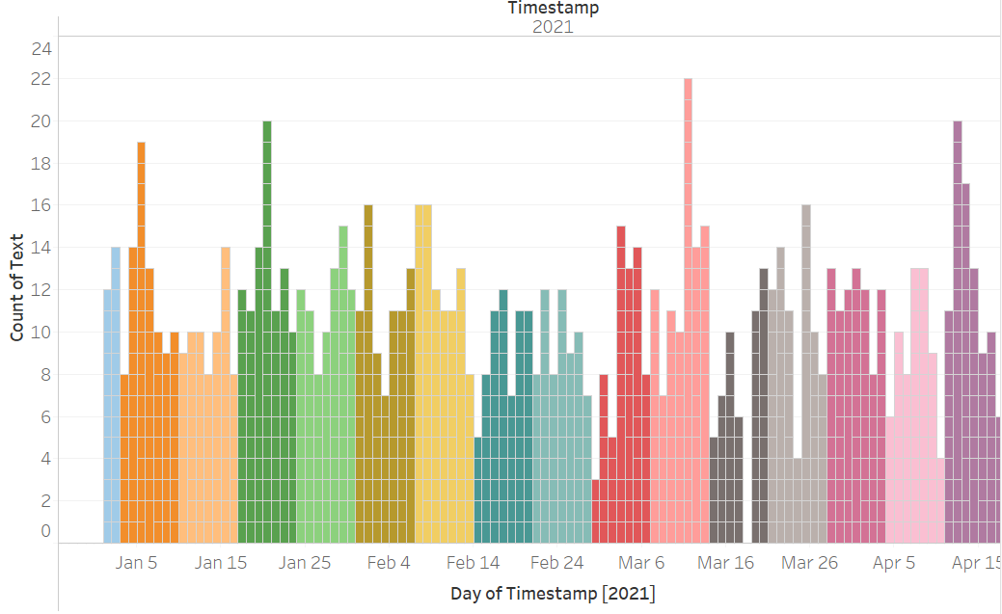
Frequency of tweets over months
It is a time variant plot and show the variation of tweet counts over months, weeks and days. Since, January quite a number of tweets could be seen and they are even consistent with a spike on some days of the week. Each week is highlighted with a unique color.

Slide 8
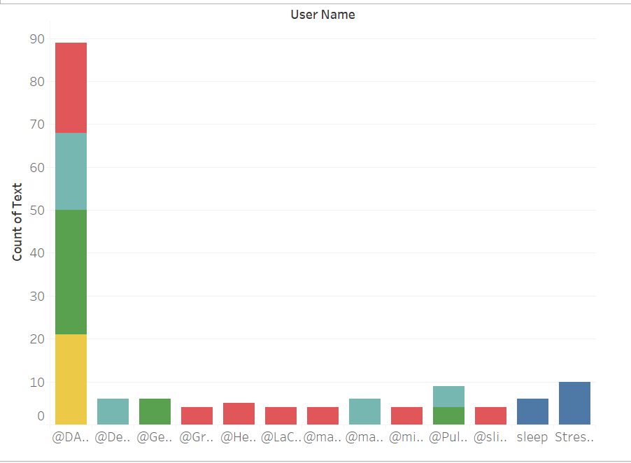
Tweet Frequency of some user
The users who tweeted more than 3 times are only considered for visualization. We can see that some users tweeted over 15 times. This kinds of frequency of tweets by users calls for attention. This could be attempt of defaming by competitors or a lambast of the product or it could either be appreciations in heft. Each month is represented using a different color in the below chart. It is evident that some twitters frequently tweeted in the month of January regarding Fitbit sense.

Slide 9
Tweet Frequency of some user
The users who tweeted more than 3 times are only considered for visualization. We can see that some users tweeted over 15 times. This kinds of frequency of tweets by users calls for attention. This could be attempt of defaming by competitors or a lambast of the product or it could either be appreciations in heft. Each month is represented using a different color in the below chart. It is evident that some twitters frequently tweeted in the month of January regarding Fitbit sense.

Slide 10
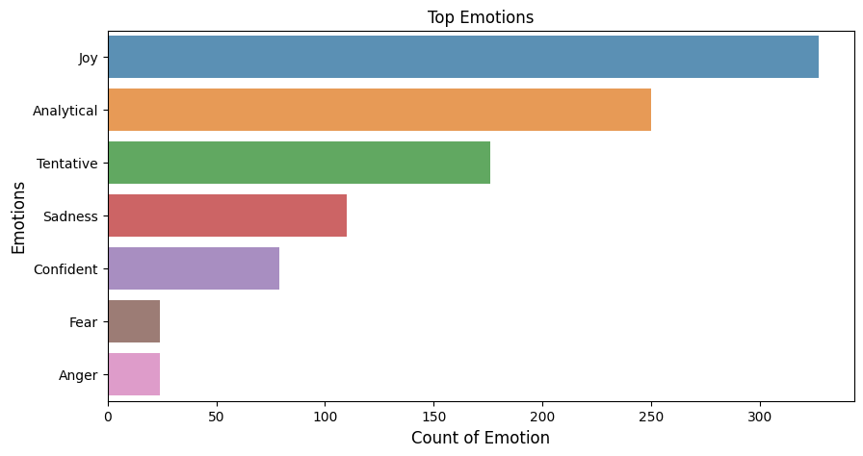
Sentiments in the post
The top emotions are seen to be joy, analytical and tentative. This shows that a a lot of customers are happy with the product. Albeit, negative emotions like Sadness, Fear and Anger are also detected in many tweets and they comprised to be a part of almost 150 tweets. This indicates that the authorities must pay attention to those users and resolve their issue hence turning them into happy customers.

Slide 11
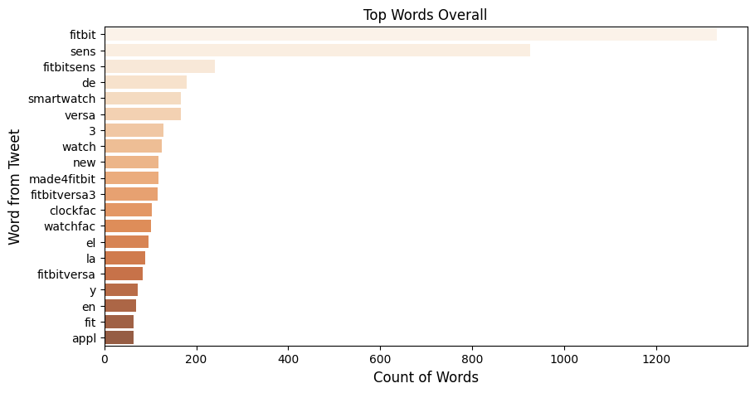
Overall words count
The top overall words found in the tweets are mostly affirmative. This doesn’t show any discrepancy. Some tweets were in different language and hence it’s the inability of the system to decipher them leading to some meaningless data.

Slide 12
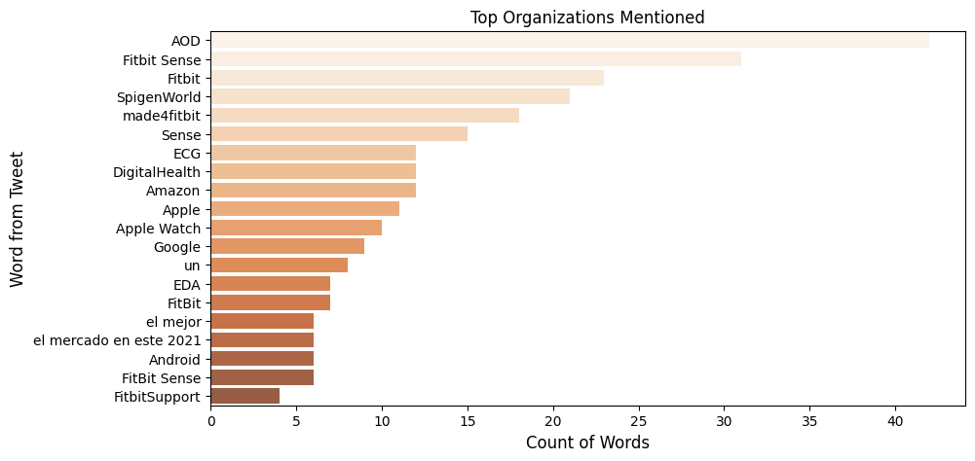
Top mentioned companies
The plot on top people mentioned is a great source to see who are the people mentioned in the tweets. If the organization wants any alter to be generated at their end if any Tweet regarding Fitbit includes any higher authority that could be analyzed using the same. However, due to existence of many tweets in other languages besides English this part is not comprehendible as well for the considered use case

Slide 13
Conclusion
Fitbit Sense is doing well as most of the responses were positive but still they have to work on that grey are to ensure that the growth is maintained and customers are retained.

Slide 14
REFERENCE LIST
Bai, Y., Hibbing, P., Mantis, C. and Welk, G.J., 2018. Comparative evaluation of heart rate-based monitors: Apple Watch vs Fitbit Charge HR. Journal of sports sciences, 36(15), pp.1734-1741...
Benedetto, S., Caldato, C., Bazzan, E., Greenwood, D.C., Pensabene, V. and Actis, P., 2018. Assessment of the Fitbit Charge 2 for monitoring heart rate. PloS one, 13(2), p.e0192691.
Chu, A.H., Ng, S.H., Paknezhad, M., Gauterin, A., Koh, D., Brown, M.S. and Müller-Riemenschneider, F., 2017. Comparison of wrist-worn Fitbit Flex and waist-worn ActiGraph for measuring steps in free-living adults. PLoS One, 12(2), p.e0172535.
de Zambotti, M., Goldstone, A., Claudatos, S., Colrain, I.M. and Baker, F.C., 2018. A validation study of Fitbit Charge 2™ compared with polysomnography in adults. Chronobiology International, 35(4), pp.465-476.
Feehan, L.M., Geldman, J., Sayre, E.C., Park, C., Ezzat, A.M., Yoo, J.Y., Hamilton, C.B. and Li, L.C., 2018. Accuracy of Fitbit devices: a systematic review and narrative syntheses of quantitative data. JMIR mHealth and uHealth, 6(8), p.e10527.
Bird, S., Klein, E. & Loper, E., 2019. Language Processing and Python. [Online] Available at: https://www.nltk.org/book/ch01.html
IBM, 2015. Overview for developers. [Online] Available at: https://cloud.ibm.com/docs/tone-analyzer?topic=tone-analyzer-overviewDevelopers [Accessed 16 10 2020].
Notes:
Bai, Y., Hibbing, P., Mantis, C. and Welk, G.J., 2018. Comparative evaluation of heart rate-based monitors: Apple Watch vs Fitbit Charge HR. Journal of sports sciences, 36(15), pp.1734-1741...
Benedetto, S., Caldato, C., Bazzan, E., Greenwood, D.C., Pensabene, V. and Actis, P., 2018. Assessment of the Fitbit Charge 2 for monitoring heart rate. PloS one, 13(2), p.e0192691.
Chu, A.H., Ng, S.H., Paknezhad, M., Gauterin, A., Koh, D., Brown, M.S. and Müller-Riemenschneider, F., 2017. Comparison of wrist-worn Fitbit Flex and waist-worn ActiGraph for measuring steps in free-living adults. PLoS One, 12(2), p.e0172535.
de Zambotti, M., Goldstone, A., Claudatos, S., Colrain, I.M. and Baker, F.C., 2018. A validation study of Fitbit Charge 2™ compared with polysomnography in adults. Chronobiology International, 35(4), pp.465-476.
Feehan, L.M., Geldman, J., Sayre, E.C., Park, C., Ezzat, A.M., Yoo, J.Y., Hamilton, C.B. and Li, L.C., 2018. Accuracy of Fitbit devices: a systematic review and narrative syntheses of quantitative data. JMIR mHealth and uHealth, 6(8), p.e10527.

Slide 15


